Slide 1
UNIT 4 Memory Management Strategies CO 4: Compare memory management techniques.

Slide 2
4.0 Introduction
4.1 Background, Swapping
4.2 Contiguous memory allocation
4.3 Paging
4.4 Structure of page table
4.5 Segmentation
4.6 External Segmentation, Internal Segmentation

Slide 3
4.0 Introduction
With CPU scheduling both the utilization of the CPU and the speed of the computer’s response to its users can be improved.
To have this increase in performance it is necessary to keep several processes in memory i,e to share memory.
The memory management algorithms vary from a primitive bare-machine approach to paging and segmentation strategies.
Each approach has its own advantages and disadvantages.
Selection of memory management method for a specific system depends on many factors, like on the hardware design of the system.
But many algorithms require hardware support and recent designs have closely integrated the hardware and OS.

Slide 4
4.1 Background, Swapping
Background
Memory is central to the operation of a modern computer system
Memory consists of a large array of words or bytes each with its own address.
The CPU fetches instructions from memory according to the value of the program counter.
Program must be brought (from disk) into memory and placed within a process for it to be run
Main memory and registers are only storage that CPU can access directly
Memory unit only sees a stream of addresses + read requests, or address + data and write requests
Main memory can take many cycles, causing a stall
Cache sits between main memory and CPU registers
Protection of memory required to ensure correct operation

Slide 5
Ex: A typical instruction execution cycle first fetches an instruction from memory.
The instruction is decoded and can cause operands to be fetched from memory.
After the instruction has been executed on the operands, results may be stored back in memory.
Memory unit sees only a stream of memory addresses but does not know how they are generated.
The memory addresses are generated by the instruction counter, indexing, indirection, literal addresses.
Basic Hardware
Main memory and the registers built into the processor itself are the only storage that the CPU can access directly.
There are machine instructions that take memory addresses as arguments but no instructions that take disk addresses.
Any instructions in execution and any data being used by the

Slide 6
Any instructions in execution and any data being used by the instructions must be moved there before the CPU can operate on them.
Registers that are built into the CPU are generally accessible within one cycle of the CPU clock.
Most CPUs can decode instructions and perform simple operations on register contents at the rate of one or more operations per clock tick.
But this is not the same for the main memory which is accessed via a transaction in the memory bus.
To complete, a memory access may take many cycles of the CPU clock.
The processor needs to wait because it does not have the data required to complete the instruction that it is executing.
This situation is intolerable because of the frequency of memory accesses.

Slide 7
The remedy is to add fast memory between the CPU and main memory.
A memory buffer used to accommodate a speed differential called a cache, is considered.
It is necessary to consider the relative speed of accessing physical memory and also necessary to ensure correct operation to protect the OS from access by user processes and in addition to protect user processes from one another.
This protection must be provided by the hardware which can be implemented in several ways.
Each process has a separate memory space. The ability is needed to determine the range necessary of legal addresses that the process may access and to ensure that the process can access only these legal addresses.
The protection can be provided by using 2 registers called a base and a limit.

Slide 8
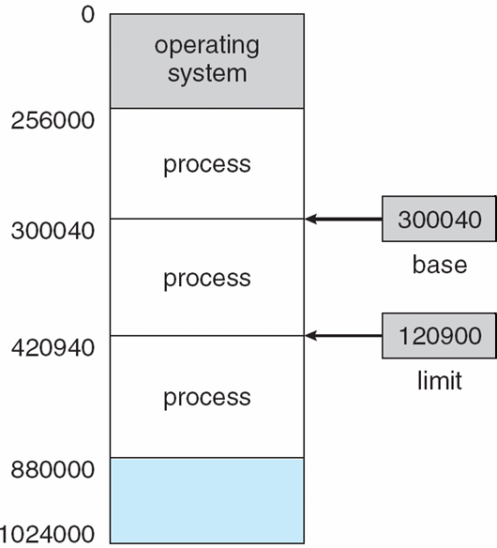
The base register holds the smallest legal physical memory address and the limit register specifies the size of the range.
CPU must check every memory access generated in user mode to be sure it is between base and limit for that user
A pair of base and limit registers define the logical address space
If the base register holds 300040 and the limit register is 120900 then the program can legally access all addresses from 300040 through 420939

Slide 9
Protection of memory space is accomplished by having the CPU hardware compare every address generated in user mode with the registers.
Any attempt by a program executing in user mode to access OS memory or other user’s memory results in a trap to the OS which treats the attempt the errors as a fatal error.
Fig: Hardware address protection with base and limit registers

Slide 10
The base and limit registers can be loaded only by the OS which uses a special privileged instruction
Privileged instructions can be executed only in kernel mode and since only the OS executes in kernel mode only the OS can load the base and limit registers.
The OS executing in kernel mode is given unrestricted access to both operating system and users memory
This provision allows the OS to load users programs into users memory to dump out those program in case of errors to access and modify parameters of system calls and so on.
Address Binding
A program resides on a disk as a binary executable file.
To be executed, program must be brought into memory and placed within a process.

Slide 11
Depending on the memory management in use, the process may be moved between disk and memory during its execution.
The processes on the disk that are waiting to be brought into memory for execution from the input queue.
The normal procedure is to select one of the processes in the input queue and to load that process into memory.
Finally, the process terminates and its memory space is declared available.
Addresses may be represented in different ways during these steps.
Addresses in the source program are symbolic such as count.
A Compiler will typically bind these symbolic adddresses to relocatable such as 14 bytes from beginning of this module.
The linkage editor or loader will in turn bind the relocatable addresses to absolute addresses such as 74014

Slide 12
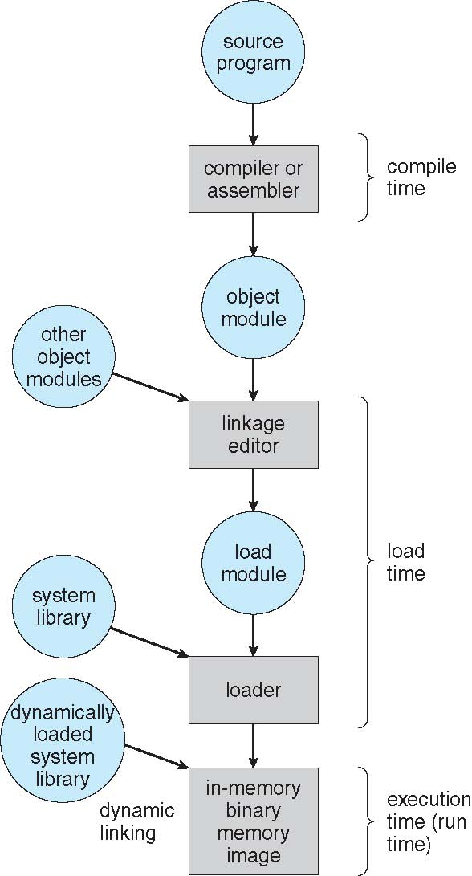
Multistep Processing of a User Program

Slide 13
Address binding of instructions and data to memory addresses can happen at three different stages
Compile time: If memory location known a priori, absolute code can be generated; must recompile code if starting location changes
Load time: Must generate relocatable code if memory location is not known at compile time
Execution time: Binding delayed until run time if the process can be moved during its execution from one memory segment to another
Need hardware support for address maps (e.g., base and limit registers)

Slide 14
Logical vs. Physical Address Space
The concept of a logical address space i,e bound to a separate physical address space is central to proper memory management
Logical address – generated by the CPU; also referred to as virtual address
Physical address – address seen by the memory unit i,e loaded into the memory address register of the memory
Logical and physical addresses are the same in compile-time and load-time address-binding schemes; logical (virtual) and physical addresses differ in execution-time address-binding scheme
Logical address space is the set of all logical addresses generated by a program
Physical address space is the set of all physical addresses generated by a program

Slide 15
The compile and load time address binding methods generate identical logical and physical address.
But the execution time address binding scheme results in differing logical and physical addresses.
The run time mapping from virtual to physical addresses is done by a hardware device called Memory Management Unit(MMU)
There are many methods to accomplish such mapping viz:
Contiguous memory allocation
Paging
Segmentation
The base register is now called relocation register
The value in the relocation register is added to every generated by a user process at the time the address is sent to memory

Slide 16
The user program deals with logical addresses; it never sees the real physical addresses
Execution-time binding occurs when reference is made to location in memory
Logical address bound to physical addresses
The Program can create a pointer to location 346, store it in the memory, manipulate it and compare it with other addresses all as the number 346
When it is used as a memory address-either in an indirect load or store, it is relocated relative to the base register
In this form of execution-time binding, the memory-mapping hardware converts logical addresses into physical addresses.
The final location of a referenced memory address is not determined until the reference is made.

Slide 17
So now there are two different types of address-
Logical addresses, which are in the range 0 to max
Physical addresses, which are in the range R+0 to R+max for a base value R
The user generates only logical addresses and thinks that the process runs in location 0 to max
The user program generates only logical addresses and thinks that the process runs in locations 0 to max. But logical addresses must be mapped to physical addresses before they are used.
The concept of logical address space i,e bound to a separate physical address space is central to proper memory management.

Slide 18
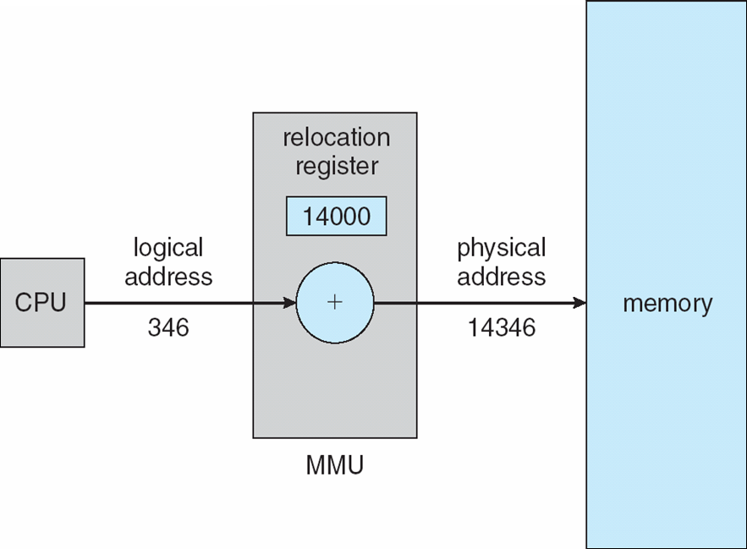
Dynamic relocation using a relocation register
Dynamic Loading
It has been necessary for the entire program and all data of a process to be in physical memory for the process to execute.
The size of a process has thus been limited to the size of physical memory

Slide 19
To obtain better memory space utilization, dynamic loading can be used.
Routine is not loaded until it is called.
Better memory-space utilization; unused routine is never loaded
All routines kept on disk in relocatable load format.
The main program is loaded in to memory and is executed.
When a routine needs to call another routine, the calling routine first checks to see whether the other routine has been loaded.
If it has not, the relocatable linking loader is called to load the desired routine into memory and to update the programs address tables to reflect this change. Then control is passed to the newly loaded routine
Advantage of Dynamic Loading is that an unused routine is never loaded.

Slide 20
Useful when large amounts of code are needed to handle infrequently occurring cases
No special support from the operating system is required
Implemented through program design
OS can help by providing libraries to implement dynamic loading
Dynamic Linking and Shared Libraries
Some OS supports Static linking – system libraries and program code combined by the loader into the binary program image
Dynamic linking –linking postponed until execution time
With dynamic linking a stub is included in the image for each library routine is not already present
Small piece of code, stub, used to locate the appropriate memory-resident library routine

Slide 21
Stub replaces itself with the address of the routine, and executes the routine
Operating system checks if routine is in processes memory address
If not in address space, add to address space
Dynamic linking is particularly useful for libraries
System also known as shared libraries
Swapping
A process can be swapped temporarily out of memory to a backing store, and then brought back into memory for continued execution
Total physical memory space of processes can exceed physical memory
Backing store – fast disk large enough to accommodate copies of all memory images for all users; must provide direct access to these memory images
Roll out, roll in – swapping variant used for priority-based scheduling algorithms; lower-priority process is swapped out so higher-priority process can be loaded and executed

Slide 22
Major part of swap time is transfer time; total transfer time is directly proportional to the amount of memory swapped
System maintains a ready queue of ready-to-run processes which have memory images on disk
Does the swapped out process need to swap back in to same physical addresses?
Depends on address binding method
Plus consider pending I/O to / from process memory space
Modified versions of swapping are found on many systems (i.e., UNIX, Linux, and Windows)
Swapping normally disabled
Started if more than threshold amount of memory allocated
Disabled again once memory demand reduced below threshold

Slide 23
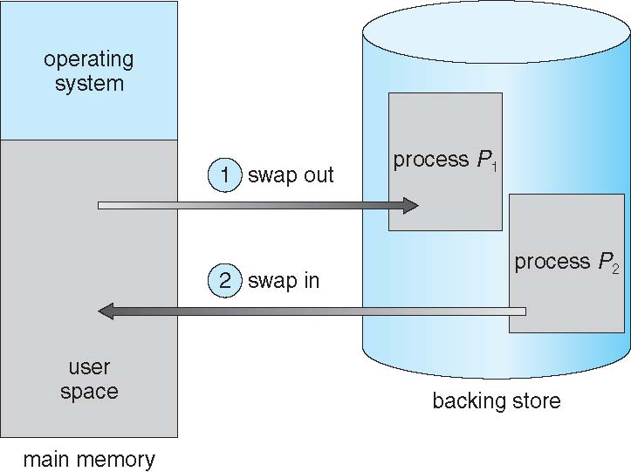
Schematic View of Swapping

Slide 24
4. 2 Contiguous Memory Allocation
Main memory must support both OS and user processes
Limited resource, must allocate efficiently
Main memory usually divided into two partitions:
Resident operating system, usually held in low memory with interrupt vector
User processes then held in high memory. Each process contained in single contiguous section of memory
Relocation registers used to protect user processes from each other, and from changing operating-system code and data
Base register contains value of smallest physical address
Limit register contains range of logical addresses – each logical address must be less than the limit register
MMU maps logical address dynamically
Can then allow actions such as kernel code being transient and kernel changing size

Slide 25
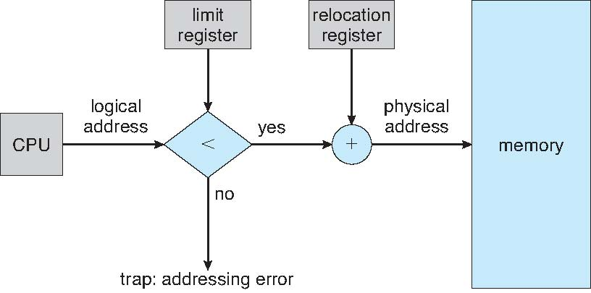
Fig: Hardware Support for Relocation and Limit Registers
Memory Mapping and Protection
Memory Mapping and Protection can be done by relocation
register
Relocation register contains the value of the smallest physical address the limit register contains the range of logical addresses.

Slide 26
With relocation and limit registers, each logical address must be less than the limit register, the MMU maps the logical address dynamically by adding the value in the relocation register.
When the CPU Scheduler selects a process for execution, the dispatcher loads the relocation and limit register with the correct values as part of the context switch.
This is because every address generated by a CPU is checked against these registers, both the OS and the users programs and data can be protected from being modified by this running process.
The relocation register scheme provides an effective way to allow the OS’s size to change dynamically.
The OS contains code and buffer space for device drivers.
If a device driver or other OS service is not commonly used, there is no need to keep the code and data in memory, because that space might be available for other purposes.

Slide 27
Memory Allocation
Simple methods for allocating memory is to divide memory into several fixed-sized partitions.
Each partition can contain exactly one process.
Thus, degree of multiprogramming is bound by the number of partitions.
In multiple partition method, when a process is selected from the input queue and is loaded into the free partition.
When the process terminate, the partition becomes available for another process.
In variable partition scheme the OS keeps a table indicating which parts of memory are available and which are occupied.
Initially all memory is available for user processes and is considered one large block of available memory- hole(block of available memory)
Finally, one can see that memory contains a set of holes of various sizes.

Slide 28
Multiple-partition allocation
Degree of multiprogramming limited by number of partitions
Variable-partition sizes for efficiency (sized to a given process’ needs)
When a process arrives, it is allocated memory from a hole large enough to accommodate it
Process exiting frees its partition, adjacent free partitions combined
Operating system maintains information about: a) allocated partitions b) free partitions (hole)
As processes enter the system they are put into an input queue.
The OS takes the information of the memory requirements of each process and the amount of available memory space in determining which processes are allocated memory.
When a process is allocated space, it is loaded into memory and it can then compete for CPU time

Slide 29
When a process terminates, it releases its memory which the OS may then fill with another process from the input queue.
Then at any given time there would be two thongs:
A list of available block sizes
An input queue
The OS can order the input queue according to a scheduling algorithm.
Memory is allocated to processes until, the memory requirements of the next process cannot be satisfied i,e no available block of memory or hole is large enough to hold that process.
The OS can then wait until a large enough block is available or it can skip down the input queue to see whether the smaller memory requirements of some other process can be sent.
When a process terminates it releases its block of memory which is then placed back in the set of holes.
If the new hole is adjacent to other holes, these adjacent holes are merged to form one larger hole.

Slide 30
At this point, the system may need to check whether there are processes waiting for memory and whether this newly freed and recombined memory could satisfy the demands of any of these waiting processes.
Dynamic Storage-Allocation Problem
How to satisfy a request of size n from a list of free holes?
The most commonly used strategies to select a free hole from the set of available holes are:
First-fit: Allocate the first hole that is big enough
Best-fit: Allocate the smallest hole that is big enough; must search entire list, unless ordered by size
Produces the smallest leftover hole
Worst-fit: Allocate the largest hole; must also search entire list
Produces the largest leftover hole
First-fit and best-fit better than worst-fit in terms of speed and storage utilization

Slide 31
Fragmentation
First fit and best fit strategies for memory allocation suffer from external fragmentation. i,e as processes are loaded and removed from memory space is broken into little pieces
External Fragmentation – total memory space exists to satisfy a request, but it is not contiguous
Internal Fragmentation – allocated memory may be slightly larger than requested memory; this size difference is memory internal to a partition, but not being used
Reduce external fragmentation by compaction
Shuffle memory contents to place all free memory together in one large block
Compaction is possible only if relocation is dynamic, and is done at execution time
I/O problem
Latch job in memory while it is involved in I/O
Do I/O only into OS buffers

Slide 32
4.3 Paging
Physical address space of a process can be noncontiguous; process is allocated physical memory whenever the latter is available
Avoids external fragmentation
Avoids problem of varying sized memory chunks
Divide physical memory into fixed-sized blocks called frames
Size is power of 2, between 512 bytes and 16 Mbytes
Divide logical memory into blocks of same size called pages
Keep track of all free frames
To run a program of size N pages, need to find N free frames and load program
Set up a page table to translate logical to physical addresses
Backing store likewise split into pages
Still have Internal fragmentation

Slide 33
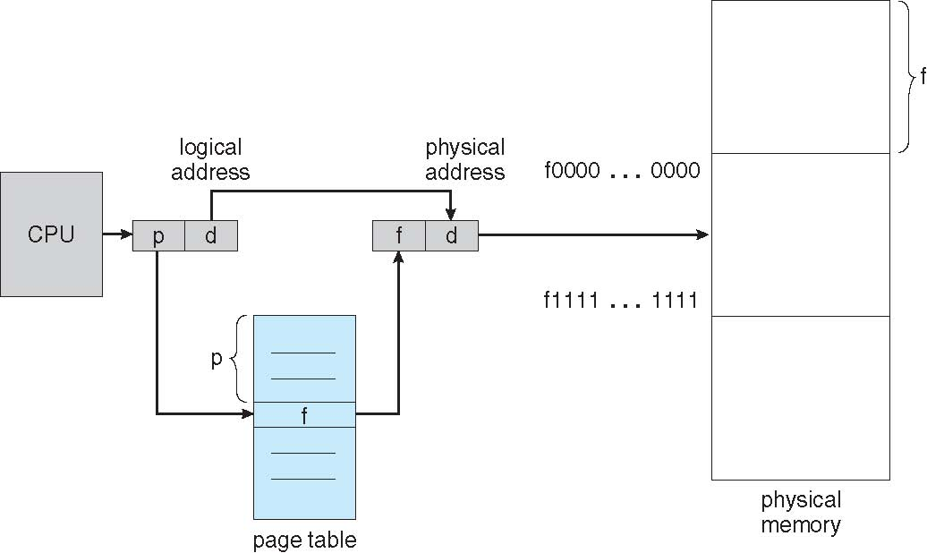
Basic Method
Basic method for implementing paging involves breaking the physical memory into fixed sized blocks called frames and breaking logical memory into blocks of the same size called pages.
When a process to be executed, its pages are loaded into any available memory frames from the backing store.
The backing store is divided into fixed-sized blocks that are of the same size as the memory frames.
Fig: Paging Hardware

Slide 34
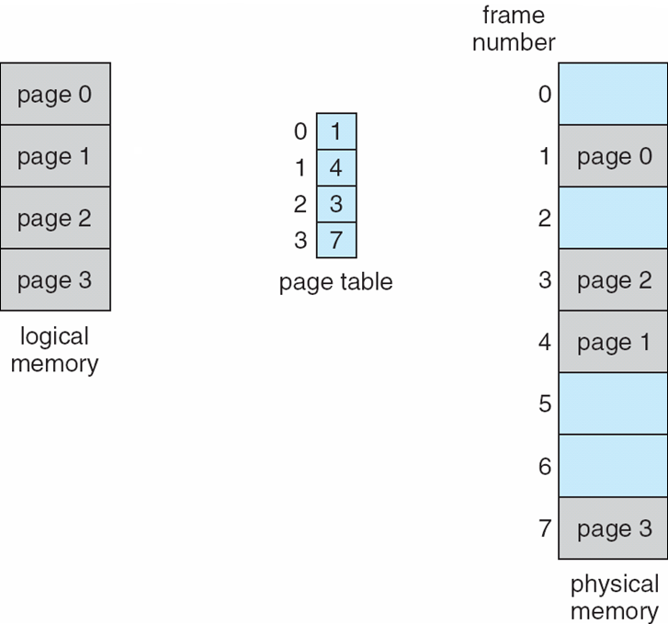
Fig: Paging Model of Logical and Physical Memory
Every address generated by the CPU is divided into two parts – page number(p) and a page offset(d).
The page number p is used as an index into a page table.
The page table contains the base address of each page in physical memory.
This base address is combined with the page in physical memory i,e sent to the memory unit.

Slide 35
Address Translation Scheme
Address generated by CPU is divided into:
Page number (p) – used as an index into a page table which contains base address of each page in physical memory
Page offset (d) – combined with base address to define the physical memory address that is sent to the memory unit
For given logical address space 2^{m} and page size 2^{n}
page number
page offset
p
d
m - n
n

Slide 36
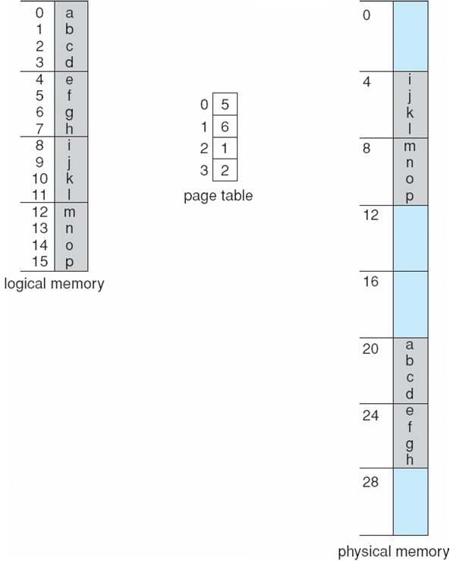
Paging Example
0
1
2
3
4
5
6
7
n=2 and m=4 32-byte memory and 4-byte pages

Slide 37
Calculating internal fragmentation
Page size = 2,048 bytes
Process size = 72,766 bytes
35 pages + 1,086 bytes – allocate 36 frames
Internal fragmentation of 2,048 - 1,086 = 962 bytes
Worst case fragmentation = 1 frame – 1 byte
On average fragmentation = 1 / 2 frame size
So small frame sizes desirable?
But each page table entry takes memory to track
Page sizes growing over time
Solaris supports two page sizes – 8 KB and 4 MB
Process view and physical memory now very different
By implementation process can only access its own memory

Slide 38
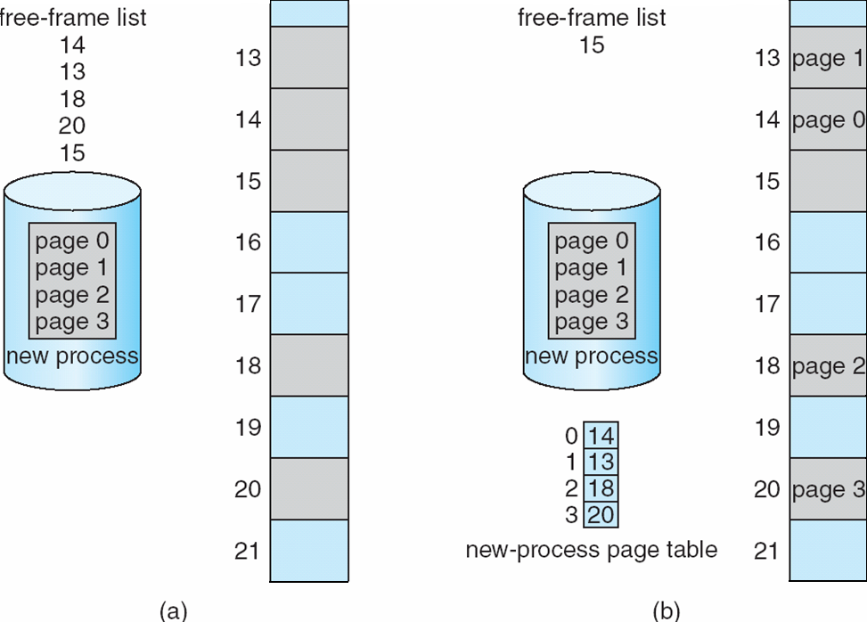
Free Frames
Before allocation
After allocation

Slide 39
When a process arrives in the system to be executed, its size, expressed in pages, is examined
Each page of the process needs one frame
Thus, if the process requires n pages, at least n frames must be available in memory.
If n frames are available, they are allocated to this arriving process.
The first page of the process is loaded into one of the allocated frames, and the frame number is put in the page table for this process.
The next page is loaded into another frame, its frame number is put into the page table and so on.

Slide 40
An important point is the clear separation between the user’s view of memory and the actual physical memory.
The user program views memory as one single space containing only this one program i,e the user program is scattered throughout physical memory, which also holds other programs.
The difference between the user’s view of memory and the actual physical memory is prepared to accept by the address translation hardware.
The logical address are translated into physical address. This mapping is hidden from the user and is controlled by the OS.
The OS is managing physical memory, it must know the allocation details of physical memory i,e which frames are allocated which frames are available, how many total frames are there and so on.

Slide 41
Hardware Support
OS has its own methods for storing page tables.
OS allocate a page table for each process.
A pointer to the page table is stored with the other register values like the instruction counter in the PCB.
Implementation of Page Table
Page table is kept in main memory
Page-table base register (PTBR) points to the page table
Page-table length register (PTLR) indicates size of the page table
In this scheme every data/instruction access requires two memory accesses
One for the page table and one for the data / instruction
The two memory access problem can be solved by the use of a special fast-lookup hardware cache called associative memory or translation look-aside buffers (TLBs)

Slide 42
TLB is associative, high speed memory.
Each entry in TLB consists of two parts- a key or tag and a value.
When the associative memory is presented with an item, the item is compared with all keys simultaneously.
If the item is found, the corresponding value field is returned.
The search is fast but the hardware required is expensive.
Some TLBs store address-space identifiers (ASIDs) in each TLB entry – uniquely identifies each process to provide address-space protection for that process
TLBs typically small (64 to 1,024 entries)
On a TLB miss, value is loaded into the TLB for faster access next time
Replacement policies must be considered
Some entries can be wired down for permanent fast access

Slide 43
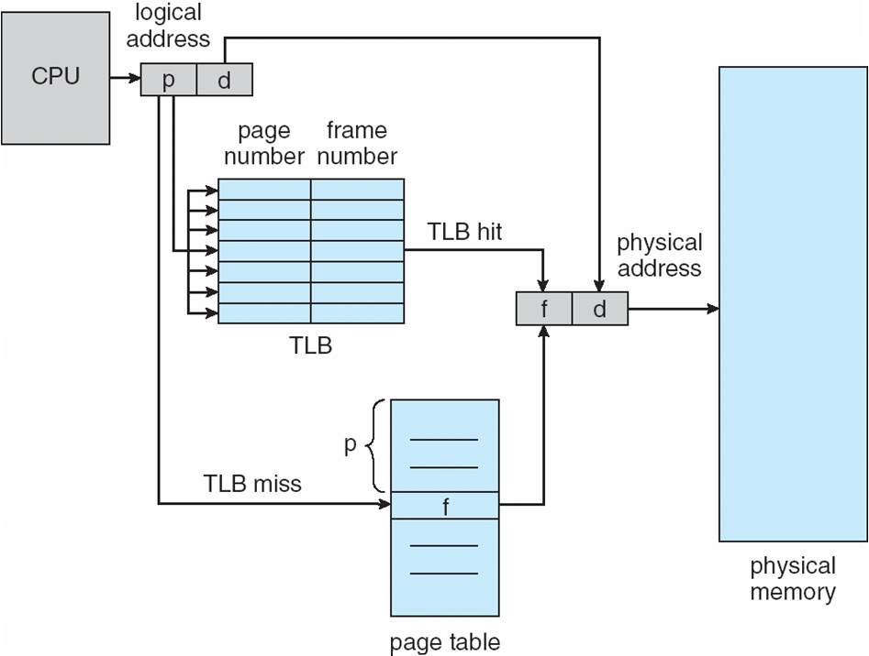
Paging Hardware With TLB

Slide 44
Protection
Memory protection implemented by associating protection bit with each frame to indicate if read-only or read-write access is allowed
Can also add more bits to indicate page execute-only, and so on
Valid-invalid bit attached to each entry in the page table:
“valid” indicates that the associated page is in the process’ logical address space, and is thus a legal page
“invalid” indicates that the page is not in the process’ logical address space
Or use page-table length register (PTLR)
Any violations result in a trap to the kernel

Slide 45
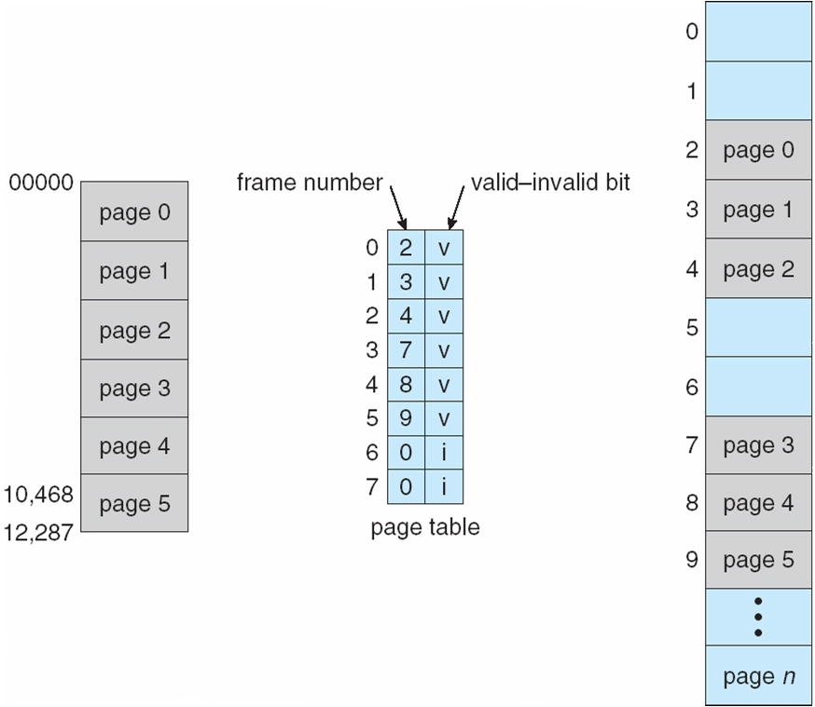
Fig: Valid (v) or Invalid (i) Bit In A Page Table

Slide 46
Shared Pages
Shared code
One copy of read-only (reentrant) code shared among processes (i.e., text editors, compilers, window systems)
Similar to multiple threads sharing the same process space
Also useful for interprocess communication if sharing of read-write pages is allowed
Private code and data
Each process keeps a separate copy of the code and data
The pages for the private code and data can appear anywhere in the logical address space

Slide 47
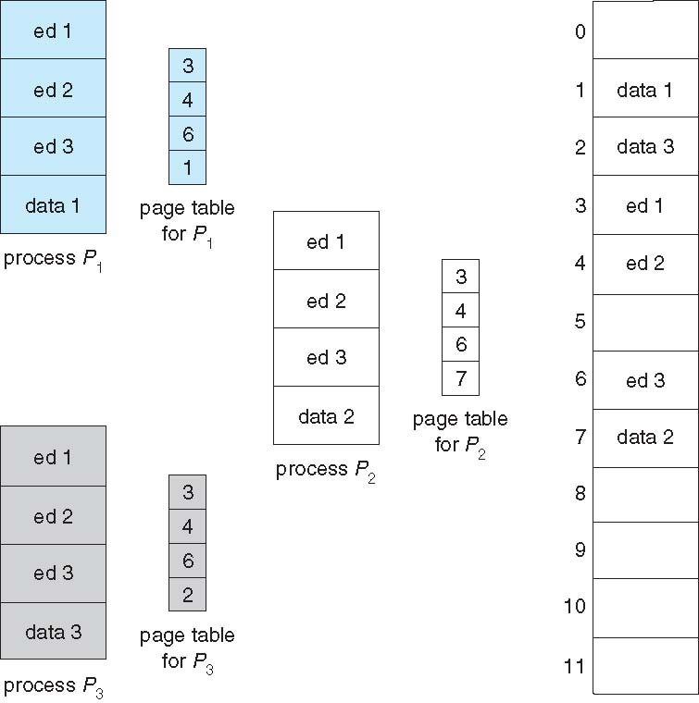
Shared Pages Example

Slide 48
4.4 Structure of the Page Table
Memory structures for paging can get huge using straight-forward methods
Consider a 32-bit logical address space as on modern computers
Page size of 4 KB (2¹²)
Page table would have 1 million entries (2³² / 2¹²)
If each entry is 4 bytes -> 4 MB of physical address space / memory for page table alone
That amount of memory used to cost a lot
Don’t want to allocate that contiguously in main memory
Following are the techniques for structuring the page tables:
Hierarchical Paging
Hashed Page Tables
Inverted Page Tables

Slide 49
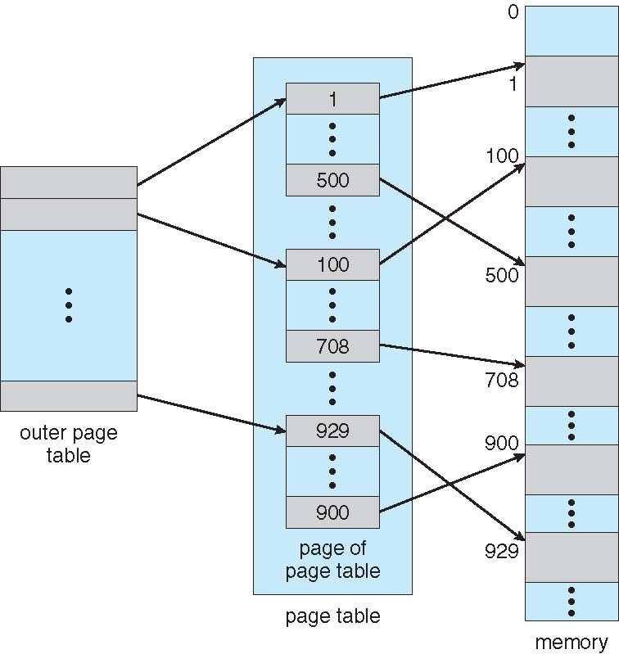
Hierarchical Page Tables
Break up the logical address space into multiple page tables
A simple technique is a two-level page table
We then page the page table
Two-Level Page-Table Scheme

Slide 50
Two-Level Paging Example
A logical address (on 32-bit machine with 1K page size) is divided into:
a page number consisting of 22 bits
a page offset consisting of 10 bits
Since the page table is paged, the page number is further divided into:
a 12-bit page number
a 10-bit page offset
Thus, a logical address is as follows:
where p₁ is an index into the outer page table, and p₂ is the displacement within the page of the inner page table
Known as forward-mapped page table
page number
page offset
p₁
p₂
d
12
10
10

Slide 51
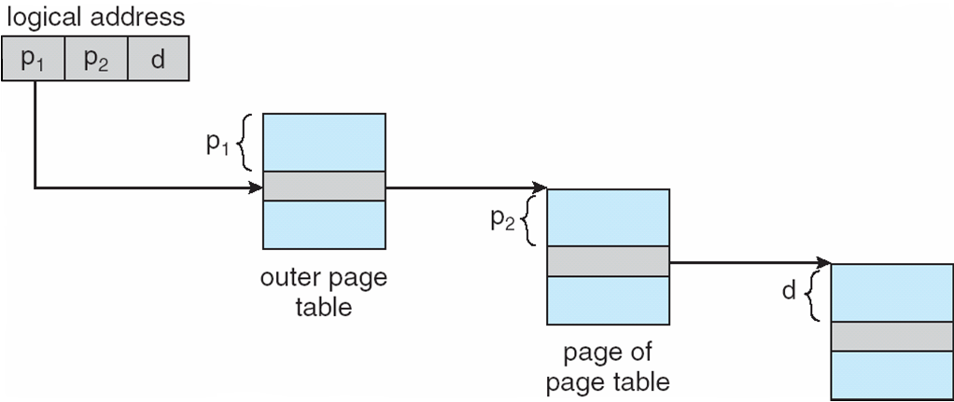
Address-Translation Scheme

Slide 52
64-bit Logical Address Space
Even two-level paging scheme not sufficient
If page size is 4 KB (2¹²)
Then page table has 2⁵² entries
If two level scheme, inner page tables could be 2¹⁰ 4-byte entries
Address would look like
Outer page table has 2⁴² entries or 2⁴⁴ bytes
One solution is to add a 2nd outer page table
But in the following example the 2nd outer page table is still 2³⁴ bytes in size
And possibly 4 memory access to get to one physical memory location
Inner
page
outer page
page offset
p₁
p₂
d
42
10
12

Slide 53
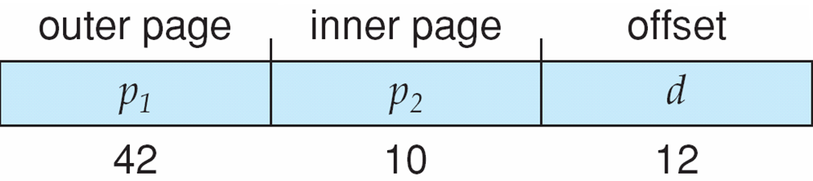
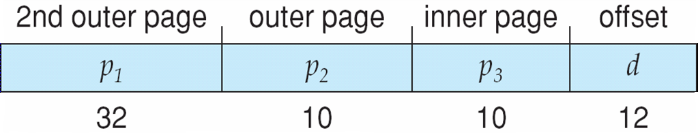
Three-level Paging Scheme

Slide 54
Hashed Page Tables
Common in address spaces > 32 bits
The virtual page number is hashed into a page table
This page table contains a chain of elements hashing to the same location
Each element contains (1) the virtual page number (2) the value of the mapped page frame (3) a pointer to the next element
Virtual page numbers are compared in this chain searching for a match
If a match is found, the corresponding physical frame is extracted
Variation for 64-bit addresses is clustered page tables
Similar to hashed but each entry refers to several pages (such as 16) rather than 1
Especially useful for sparse address spaces (where memory references are non-contiguous and scattered)

Slide 55
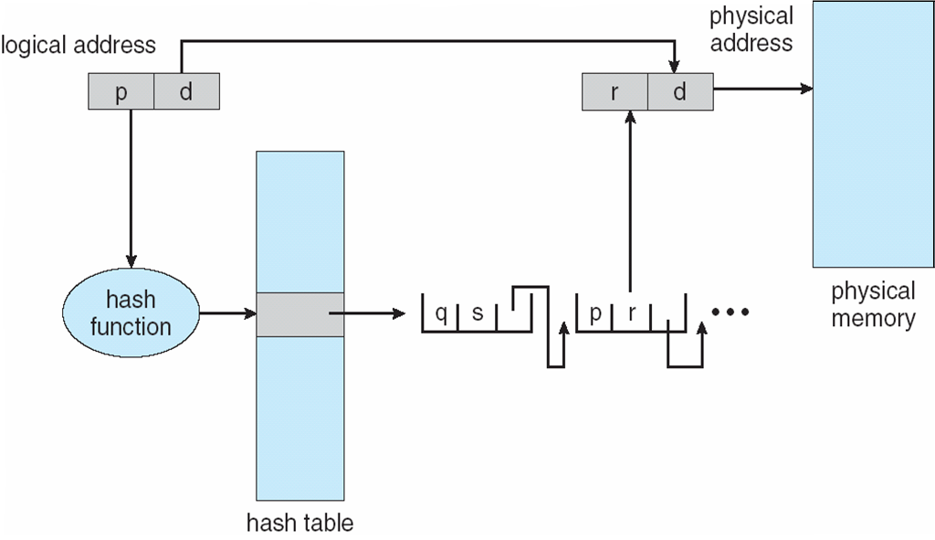
Hashed Page Table

Slide 56
Inverted Page Table
Rather than each process having a page table and keeping track of all possible logical pages, track all physical pages
One entry for each real page of memory
Entry consists of the virtual address of the page stored in that real memory location, with information about the process that owns that page
Decreases memory needed to store each page table, but increases time needed to search the table when a page reference occurs
Use hash table to limit the search to one — or at most a few — page-table entries
TLB can accelerate access
But how to implement shared memory?
One mapping of a virtual address to the shared physical address

Slide 57
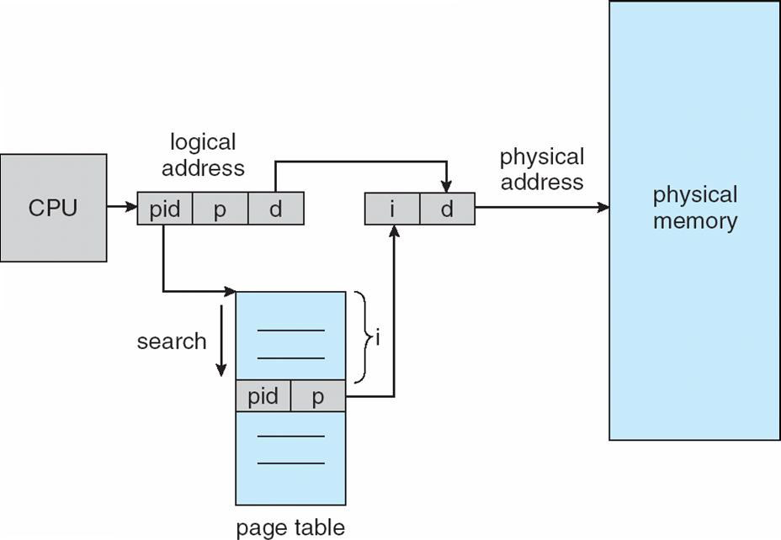
Inverted Page Table Architecture

Slide 58
4.5 Segmentation
Separation of the user’s view of memory from the actual physical memory
User’s view of memory is not the same as the actual physical memory.
Memory-management scheme that supports user view of memory
A program is a collection of segments
A segment is a logical unit such as:
main program
procedure
function
method
object
local variables, global variables
common block
stack
symbol table
arrays

Slide 59
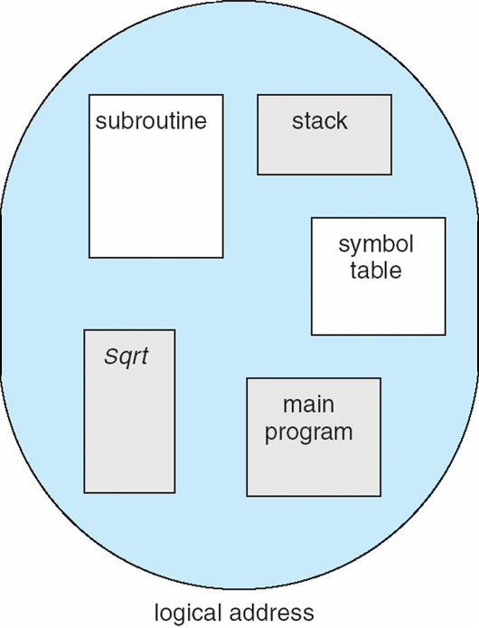
User’s View of a Program
Basic Method
Users do not think of memory as a linear array of bytes, some containing instructions and others containing data.
Most people or users prefer to view memory as a collection of variable-sized segments with no necessary ordering among segments.

Slide 60
Segmentation is a memory management scheme that supports this user view of memory.
A logical address space is a collection of segments
Each segment has name and length
The addresses specify both the segment name and the offset within the segment
The user therefore specifies each address by two quantities a segment name and an offset

Slide 61
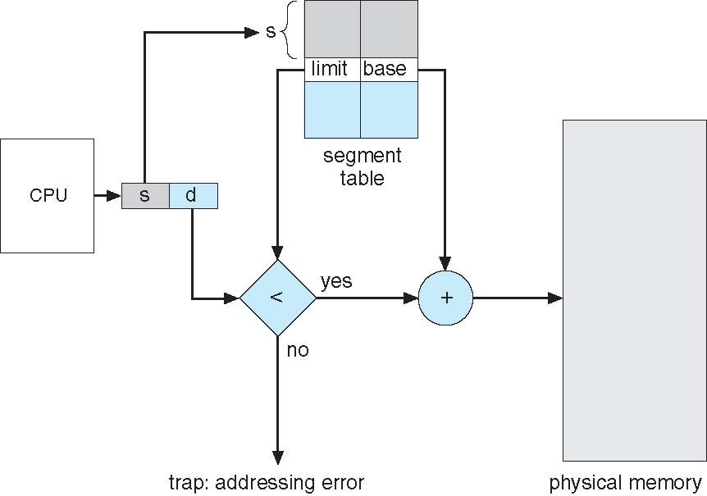
Fig: Segmentation Hardware

Slide 62
Logical View of Segmentation
1
1
4
2
3
4
2
3
user space
physical memory space

Slide 63
Segmentation Architecture
Logical address consists of a two tuple:
<segment-number, offset>,
Segment table – maps two-dimensional physical addresses; each table entry has:
base – contains the starting physical address where the segments reside in memory
limit – specifies the length of the segment
Segment-table base register (STBR) points to the segment table’s location in memory
Segment-table length register (STLR) indicates number of segments used by a program;
segment number s is legal if s < STLR

Slide 64
Protection
With each entry in segment table associate:
validation bit = 0 ⇒ illegal segment
read/write/execute privileges
Protection bits associated with segments; code sharing occurs at segment level
Since segments vary in length, memory allocation is a dynamic storage-allocation problem
A segmentation example is shown in the following diagram

Slide 65
4.6 External Segmentation, Internal Segmentation
External Fragmentation
Total memory space is enough to satisfy a request or to reside a process in it, but it is not contiguous, so it cannot be used. External fragmentation can be reduced by compaction or shuffle memory contents to place all free memory together in one large block. To make compaction feasible, relocation should be dynamic.
Internal Fragmentation
Memory block assigned to process is bigger. Some portion of memory is left unused, as it cannot be used by another process. The internal fragmentation can be reduced by effectively assigning the smallest partition but large enough for the process.

Slide 66
Key | Internal Fragmentation | External Fragmentation
Definition | When there is a difference between required memory space vs allotted memory space, problem is termed as Internal Fragmentation. | When there are small and non-contiguous memory blocks which cannot be assigned to any process, the problem is termed as External Fragmentation.
Memory Block Size | Internal Fragmentation occurs when allotted memory blocks are of fixed size. | External Fragmentation occurs when allotted memory blocks are of varying size.
Occurrence | Internal Fragmentation occurs when a process needs more space than the size of allotted memory block or use less space. | External Fragmentation occurs when a process is removed from the main memory.
Solution | Best Fit Block Search is the solution for internal fragmentation. | Compaction is the solution for external fragmentation.
Process | Internal Fragmentation occurs when Paging is employed. | External Fragmentation occurs when Segmentation is employed.

